Slide 1
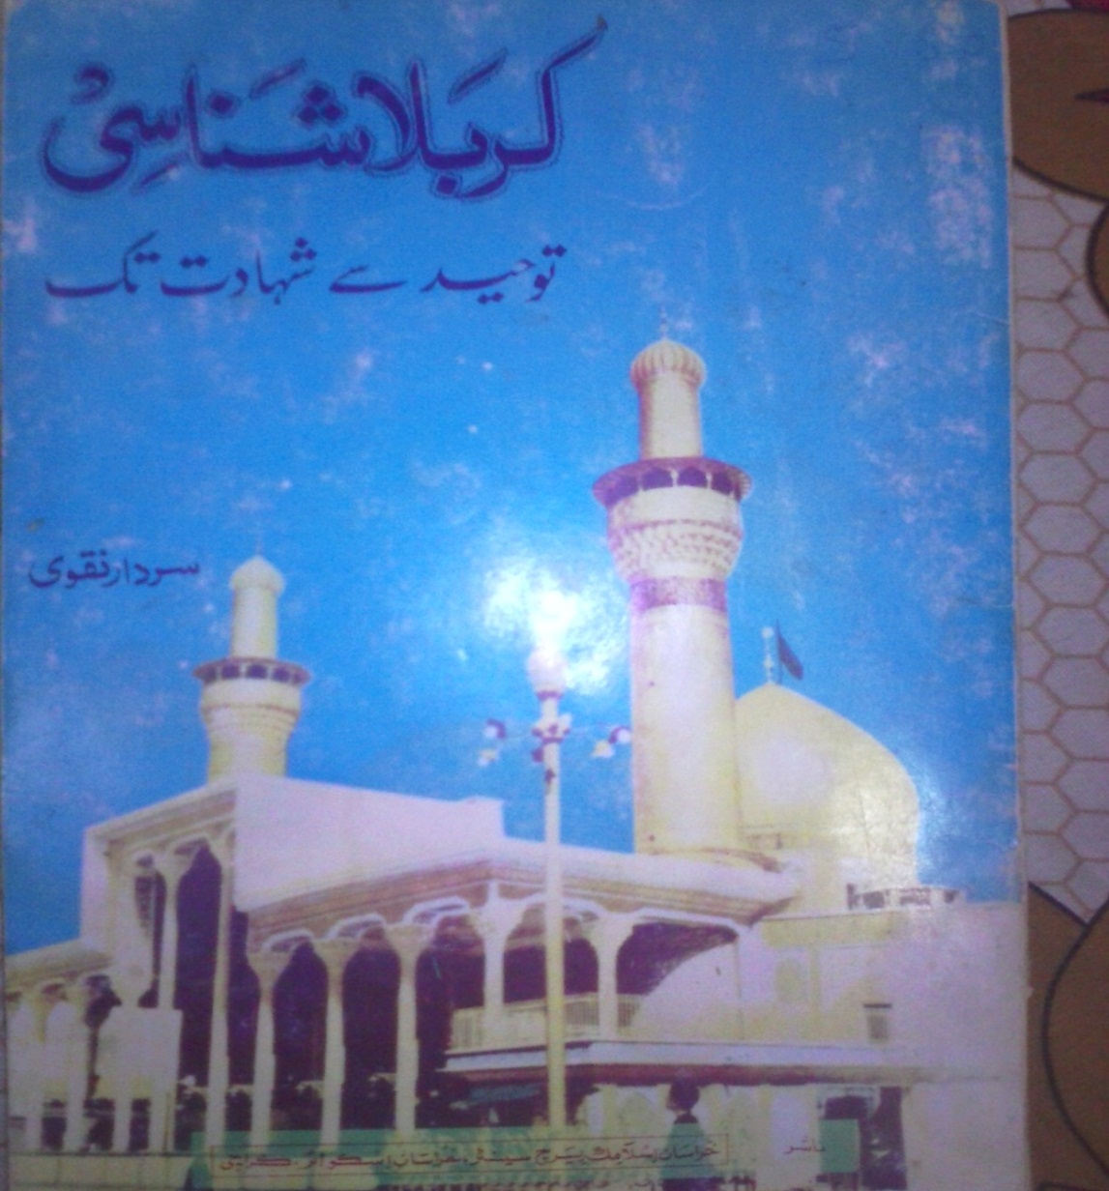
Karbala Shinasi
Tauheed se shahadat tak
-SYED SARDAR NAQVI

Slide 2
CONTENTS
TAUHEED O ADAL
HAZRAT KHADIJA AUR HAZRAT ABUTALIB
HIJRAT E MADINA OR FATH E MAKKAH
DAMISHQ AUR ABUZAR
HAZRAT ALI OR IMAM HASAN
KARBALA AUR HUSSAIN

Slide 3
TAUHEED O ADAL
ISLAM
INSAAN OR RASOOL
TARAQQI
IKHTALAAF
RASOOL

Slide 4
HAZRAT KHADIJA AUR HAZRAT ABUTALIB
ELAAN E NABUWWAT SAY PEHLE
JANAAB E KHADIJA
ABU TALIB AUR UN KI OLAAD
DUSHMANON KA DARNA

Slide 5
HIJRAT E MADINA OR FATH E MAKKAH
MASJID
FIR’OUN KI MISAAL
BADR
OHAD
KA’ABA

Slide 6
FATH E MAKKAH
ABU SUFYAAN
RASOOL KI MOAFI
INTEQAAL
RASOOL KA SHAHEED NA HONA

Slide 7
DAMISHK AUR ABUZAR
ZABANI MUSALMAN
ISLAM K NAAM PAR HUKUMAT
DAMISHK K HAALAT AUR ABUZAR
DAMISHK MEIN RUKNA

Slide 8
MUAVIYA KI MUKHALIFAT
HAZRAT USMAN SAY MANAZIRA
JILA WATNI
HAZRAT ALI KI HIMAYAT

Slide 9
HAZRAT ALI OR IMAM HASAN
HUKUMAT
AMEER AUR GHAREEB
QANOON E QURAN
MUAVIYA KI MUKHALIFAT
JANG BANDI
AMMAR E YASIR KI SHAHADAT

Slide 10
MUAVIYAH KI CHAAL
IMAM HASAN KI SULAH
SULAH NAAMA(Pg 61)
MUAHIDA TORNA
MUAVIYAH KI KA KHUTBA
HAQ O BATIL MEIN DARAAR

Slide 11
KARBALA AUR HUSSAIN
YAZEED
ZINDAGI
BANU HASHIM PR YAZEED KI TOHMAT
BAIYAT KA MUTALBA
IMAM KI HIJRAT
KUFA K KHUTOOT

Slide 12
MUSLIM BIN AQEEL
HUR
KARBALA
PANI KI BANDISH
KARBALA KI QURBANI AUR JANAAB E IBRAHEEM
SAJDAY MEIN SHAHADAT

Slide 13
CONCLUSION
KHOONE HUSSAIN NAY HAQ OR BATIL K DARMIYAAN WAZAY FARQ QAIM KARDIYAH

